Slide 1
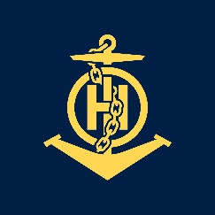
Alumni Presentation
IHO – NIPPON FOUNDATION
ALUMNI SEMINAR
Muhammad Aizat bin Azmi

Slide 2
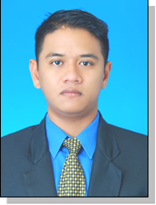
Self introduction
IHO – NIPPON FOUNDATION
ALUMNI SEMINAR
Name | Muhammad Aizat Azmi
Alumni year | 2017
Country | Malaysia
Organization | National Hydrographic Centre
Position/Job title | In Charge of Electronic Navigational Chart Production
Current job description | As Staff Officer (Electronic Navigational Chart) responsible for ensuring that my subordinates produce ENC in accordance with the correct rules and comply with Standards set by IHO within the planned timeframe. directly involved in producing ENC from data compilation process using Caris Source Editor to product revenue using Caris Product Editor. exposed to data validation process using dKart software. I would like to know deeper into the ENC validation process.

Slide 3
My Career Path And Projects / Achievements
IHO – NIPPON FOUNDATION
ALUMNI SEMINAR
FIG/IHO/ICA Category B (Cat-B) Hydrographic Surveyor Course
Hydrographic Training Centre, Indonesian Navy (TNI-AL)
Bilateral Malaysian-Australian
Defence Program
RAN Survey Vessel
HMAS MELVILLE
3rd IC-ENC Technical Conferrence
Bristol, UK
2010
2014 - 2015
2017
2019
2013
2016
2018
4th EAHC SC Meeting
MSS-ENC SC Meeting
Tokyo, Japan
IHO-Nippon Foundation CHART Program
UKHO, Taunton, UK
2nd MSS-ENC Workshop
Jakarta, Indonesia
IHO – Nippon Foundation Alumni Seminar
Singapore
Bachelor of Science (Nautical) (CGPA: 3.56) University of Technology, Malaysia (UTM)
Field Surveyor/Navigator
RMN Survey Vessel
KD MUTIARA

Slide 4
Lessons learned from CHART Course
IHO – NIPPON FOUNDATION
ALUMNI SEMINAR
Fundamentals of Charting
Database Compilation
ENC Production
Paper Chart Production
Data Assessment and Product Maintenance
Networking

Slide 5
Suggestion for the future
IHO – NIPPON FOUNDATION
ALUMNI SEMINAR
Cartographic Advance Course
S-100 series workshop/seminar

Slide 6
THANK YOU

